Slide 1
Hyperplonk: Plonk with linear-time prover and high degree gates
Binyi Chen
Espresso Systems
Dan Boneh
Stanford
Benedikt Bünz
Espresso Systems, Stanford
Zhenfei Zhang
Espresso Systems
Notes:
An adaptation of Plonk to the boolean hypercube, using multilinear polynomial commitments
The scheme has linear-time prover and very nice high-degree custom gate support.
3. Also highly parallelizable/hardware-friendly, fully removes the use of FFTs

Slide 2



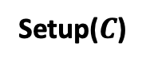
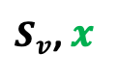
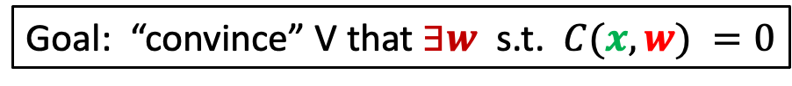
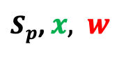
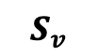
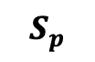
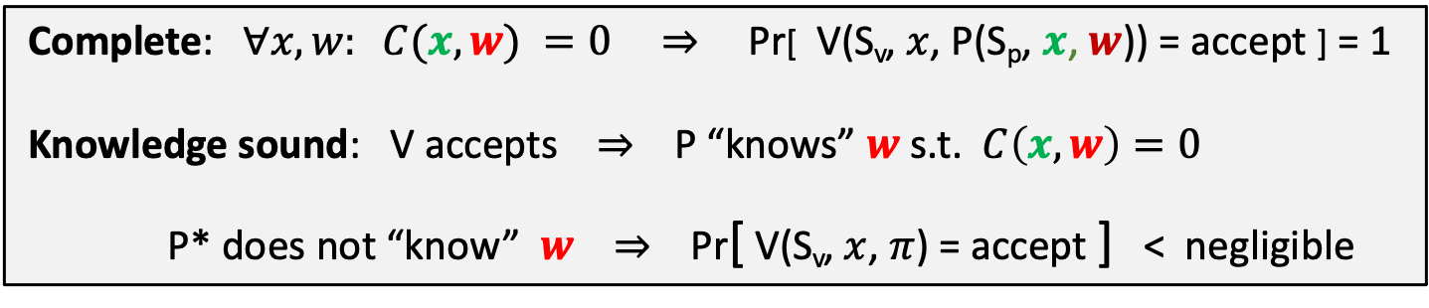
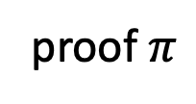

Preprocessing (zk)-SNARKs
Goal: “convince” V that $∃w$ s.t. $C(x, w) =0$
Setup($C$)
$S_{p}$, $x,$ $w$
$$S_{p}$$
$$S_{v}$$
$S_{v}$, $x$
proof $π$
Accept/Reject
Prover
Verifier
Complete: $∀x, w: C(x, w) =0$ ⇒ Pr[ V(S_{v}, $x$, P(S_{p}, $x$, $w$)) = accept ] = 1
Knowledge sound: V accepts ⇒ P “knows” $w$ s.t. $C\left(x, w\right)=0$
P* does not “know” $w$ ⇒ Pr[ V(S_{v}, $x$, $π$) = accept ] < negligible
Succinct: $|π|=O( \log\left(\left|C\right|\right), λ)$, time(V) = $O(\left|x\right|, \log\left(\left|C\right|\right), λ)$
Optional: Zero knowledge: ($Sv ,x$, $π$) “reveals nothing” about $w$
Notes:
Briefly review the notions of SNARKs and its building blocks
SNARKs is a scheme that enables a prover convinces a verifier that he knows a valid witness to a public circuit w.r.t. a public input, with small communication and verification cost
Setup: takes as input the circuit and out P/V parameters and send them to P/V respectively
Prover: given witness/inp/param, computes a proof pi and send it
Verifier: check the proof and outputs accept/reject
Complete, knowledge sound (informally, if the verifier accepts some proof, we can extract the witness from the corresponding prover that generates this proof)
Succinct proof and efficient verification, namely, logarithmic to the circuit size
Optionally ZK

Slide 3

General paradigm for modern SNARKs
Many SNARKs are built in two steps:
polynomial
interactive oracle proofs
(poly-IOP)
polynomial
commitment
scheme
KZG,
IPA-based,
Fri-based,
DARK,
…
PLONK,
Sonic,
Marlin,
Libra,
…
(zk)SNARK for general circuits
Notes:
Many recent SNARKs were built using the following framework
Start with an interactive protocol in the ideal world called PolyIOP; Plonk, ….
Then compile the ideal protocol into a non-interactive succinct argument using a crypto-primitive called PCS, example includes…
This framework is highly flexible and modular, meaning that one can combine ….

Slide 4
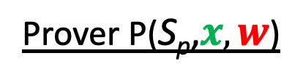
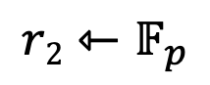
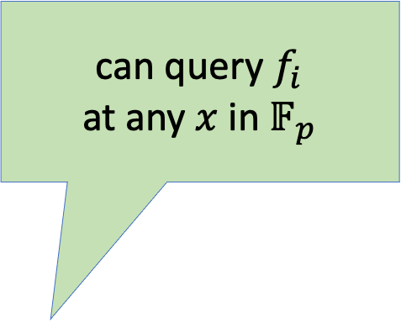
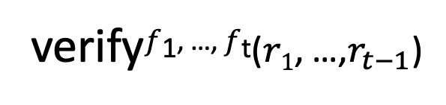
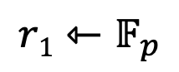
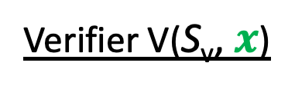
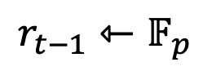
Polynomial IOP[BCS16,CHMMVW19,BFS19]
Prover P($\text{S}\text{p}\text{,}x, w$)
Verifier V($\text{S}\text{v}\text{, }x$)
$f1$ ${∈ 𝔽}_{p}^{(≤d)}\left[X\right]$
Oracle
$$r1⇽𝔽_{p}$$
Easily extendable to the multivariate polynomial setting
$r$₁
$f2$ ${∈ 𝔽}_{p}^{(≤d)}\left[X\right]$
Oracle
$$r2⇽𝔽_{p}$$
$r$₂
can query $f_{i}$ at any $x$ in $𝔽_{p}$
⋮
$$r_{t−1}$$
$$r_{t−1}⇽𝔽_{p}$$
$ft$ ${∈ 𝔽}_{p}^{(≤d)}\left[X\right]$
Oracle
verify$f$^{1, …,} $f$^{t}($r1$, …,$r_{t−1}$)
Notes:
We start by explaining what are polynomial interactive oracle proofs
In each round, the prover/preprocessor sends some polynomial oracle to verifier
The verifier reply with some challenges, and finally the verifier can check some evals of the polys
Note the polynomials are not restricted to be univariate, we can extend to multivariate polys
However, this protocol is certainly not a SNARK: interactive, polynomial is too large to be sent and too costly for verifier to evaluate
Hence, we need some crypto-primitive to compress the polynomials and enable efficient evaluation checkings; and the primitive is so-called…

Slide 5
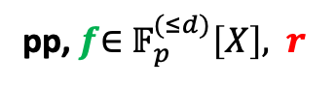

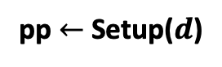

Polynomial Commitment [KZG10]
Committing phase
pp $←$Setup($d$)
pp, $f\text{∈ }𝔽_{p}^{(≤d)}\left[X\right],$ $r$
pp
commit(pp, f, $r$) ⇾ com_{f}
Prover
Verifier
Binding: cannot output two valid openings ($f_{1}$, $r_{1}$), ($f_{2}$, $r_{2}$) for com_{f}.
Optional: commitment $com_{f}$is hiding
Notes:
Given a polynomial with some bounded degree d, the PCS enables a prover to commit it to a short bitstring which length is independent of the degree
The commitment should be binding so that….open it to two different bounded-deg polys
Optionally, the commitment can be also hiding….

Slide 6
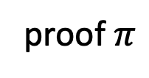
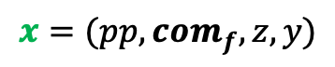
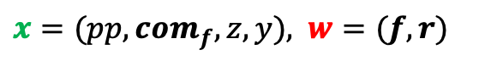
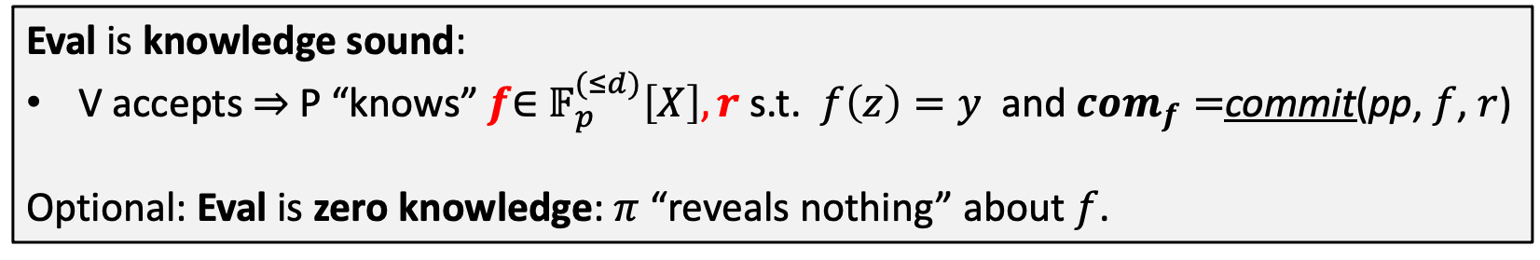
Polynomial Commitment
Evaluation phase
Goal: “convince” V that $f\left(z\right)=y$ and $com_{f}=$commit(pp, $f$, $r$)
$x=(pp, com_{f}, z, y),$ $w=(f, r)$
$$x=(pp, com_{f}, z, y)$$
proof $π$
Accept/Reject
Prover
Verifier
Eval is knowledge sound:
V accepts ⇒ P “knows” $f\text{∈ }𝔽_{p}^{(≤d)}\left[X\right], r$ s.t. $f\left(z\right)=y$ and $com_{f}=$commit(pp, $f$, $r$)
Optional: Eval is zero knowledge: $π$ “reveals nothing” about $f$.
Notes:
PCS also allows a verifier to efficiently check that a poly evaluation is correct w.r.t. the committed poly
The prover will generate a succinct evaluation proof that is knowledge sound, meaning that …
Optionally, sometimes the evaluation proof is also ZK, meaning that ….

Slide 7
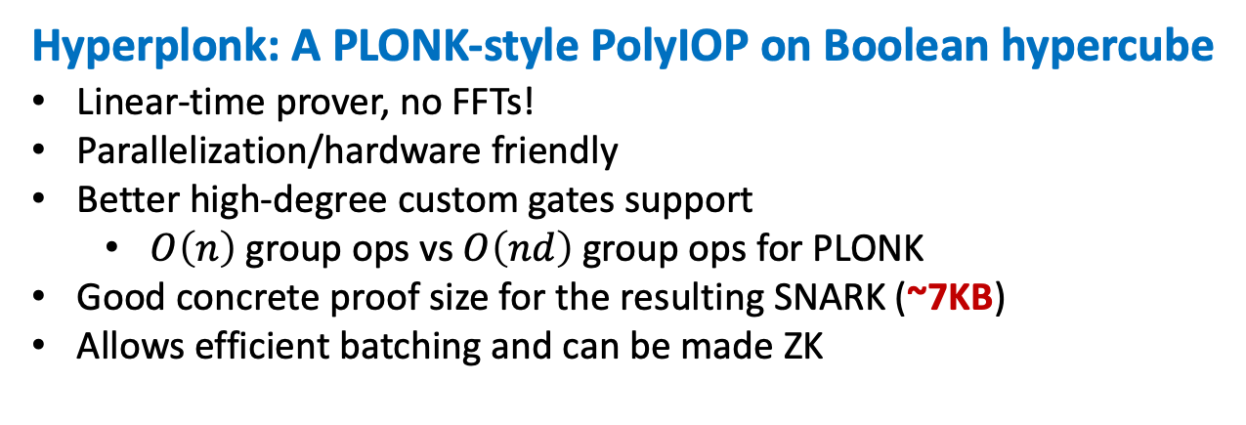
Our Contributions
Hyperplonk: A PLONK-style PolyIOP on Boolean hypercube
Linear-time prover, no FFTs!
Parallelization/hardware friendly
Better high-degree custom gates support
$O\left(n\right)$ group ops vs $O\left(nd\right)$ group ops for PLONK
Good concrete proof size for the resulting SNARK (~7KB)
Allows efficient batching and can be made ZK
Plookup on the
Boolean hypercube
New multilinear polynomial commitment schemes
Orion-based
Preserve linear-time prover
Improved proof size: 5MB -> 7KB
FRI-based
Simple transform from any univariate-FRI-based PCS
Hyperplonk+: Hyperplonk with lookup
First linear-time lookup argument
Notes:
Now we are ready to state our main results
A new multivariate PIOP that adapts Plonk to the Boolean hypercube
Fully linear and highly parallelizable, as it removes the use of FFTs
Provides better high-degree custom gate support.
Custom gate is a Plonk’s nice feature that developers can design their own gate types for apps to minimize the circuit size. E.g., with a high-deg gate one can express an ECC addition with only 2 constraint.
However, the number of group exps of Plonk is …., which limits its feasibility of using super-high deg gate
In comparison, …
Lookup: useful for apps like zkEVM, which heavily use lookup gates
New multilinear commitments that can all be combined with HyperPlonk
1. Orion/FRI

Slide 8
Outline
Adapt Plonk to the Boolean hypercube
High-degree gates support and batching
Hyperplonk+: support lookup on the Boolean hypercube
Evaluations
Notes:
The rest of the talk is organized as follows, we’ll first explain how to adapt Plonk to the multivariate polynomial setting; then explains how it handles high-degree gates; next, we’ll describe the techniques for supporting lookup in the multilinear setting; finally, we’ll provide some evaluations and benchmarks

Slide 9
Outline
Adapt Plonk to the Boolean hypercube
High-degree gates support and batching
Hyperplonk+: support lookup on the Boolean hypercube
Evaluations

Slide 10
PLONK workflow [GWC19]
Compile a circuit to a trace
Encode the trace as univariate polynomials
Prove that the trace encodes a valid circuit computation
Gate identity check
Wiring identity check
Notes:
Before describing HyperPlonk, we quickly review the workflow of PLONK
Given an arithmetic circuit, …

Slide 11
PLONK’s Circuit Encoding
[GWC19]
The computation trace:
$$(x1+x2)(x2+w1)$$
inputs: 5, 6, 1
Claimed output: 77
Gate 0: 5 , 6 , 11
Gate 1: 6 , 1 , 7
Gate 2: 11, 7, 77
77
$$\text{×}$$
(Gate 2)
11
7
(Gate 0)
$$+$$
$$+$$
(Gate 1)
5
6
1
6
$$x1$$
$$x2$$
$$w1$$
left inputs
right inputs
outputs
5
6
1
example input
Notes:
given a fan-in-2 arithmetic circuit with n gates, we translate it into a matrix with n rows and 3 columns, where each row maps to a gate and the 3 columns corresponds to left/right inputs and the output of the gate

Slide 12
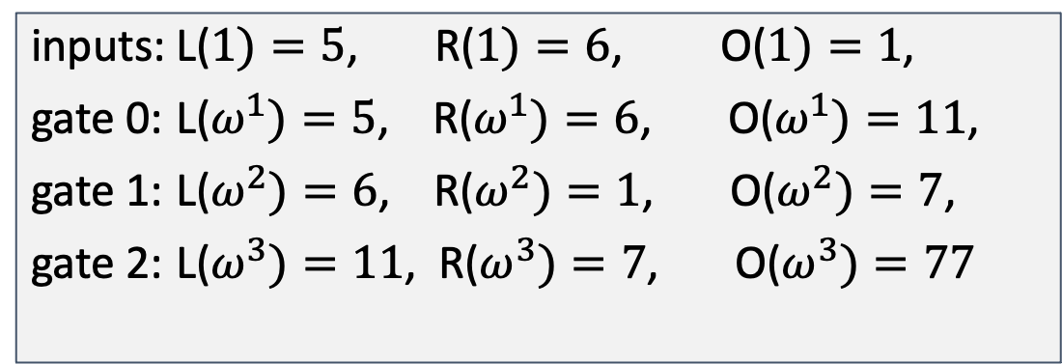
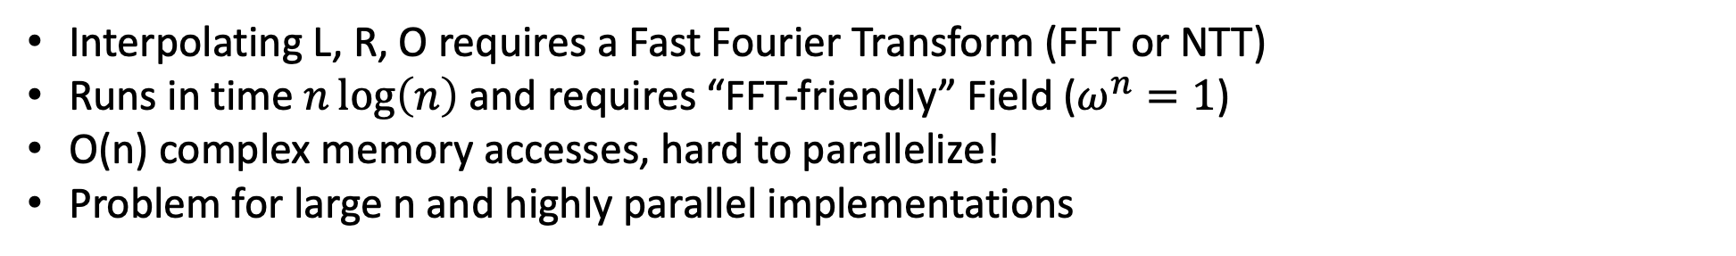
PLONK: Trace to Polynomial [GWC19]
The computation trace:
The polynomials:
inputs: 5, 6, 1
Claimed output: 77
Gate 0: 5 , 6 , 11
Gate 1: 6 , 1 , 7
Gate 2: 11, 7, 77
inputs: L($1)=5$, R($1)=6$, O($1)=1$,
gate 0: L($ω^{1})=5$, R($ω^{1})=6$, O($ω^{1})=11$,
gate 1: L($ω^{2})=6$, R($ω^{2})=1$, O($ω^{2})=7$,
gate 2: L($ω^{3})=11$, R($ω^{3})=7$, O($ω^{3})=77$
Interpolating L, R, O requires a Fast Fourier Transform (FFT or NTT)
Runs in time $n\log\left(n\right)$ and requires “FFT-friendly” Field ($ω^{n}=1$)
O(n) complex memory accesses, hard to parallelize!
Problem for large n and highly parallel implementations
Notes:
Plonk uses univariate polynomials to interpolate the columns of the matrix so that it can conveniently conduct polynomial equation checks later.

Slide 13
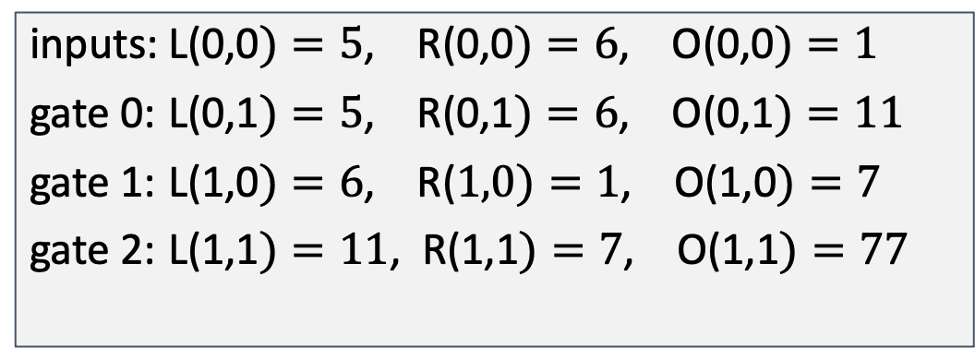
Hyperplonk: Trace to Multilinear Polynomial
The computation trace:
The polynomial P:
inputs: 5, 6, 1
Claimed output: 77
Gate 0: 5 , 6 , 11
Gate 1: 6 , 1 , 7
Gate 2: 11, 7, 77
inputs: L(0,0$)=5$, R(0,0$)=6$, O(0,0$)=1$
gate 0: L(0,1$)=5$, R(0,1$)=6$, O(0,1$)=11$
gate 1: L(1,0$)=6$, R($1,0)=1$, O(1,0$)=7$
gate 2: L(1,1$)=11$, R(1,1$)=7$, O(1,1$)=77$
Polynomials are represented in evaluation form, no need for coeff/eval transform
Linear in each variables
Log(n) variables
Efficient poly-commits available (KZG-based, FRI-based, BP, Dory, …) O(log(n))-sized
Similar idea to Spartan, Quarks (But they work for R1CS)
Notes:
We address the issue by interpolating the matrix using multilinear polynomials

Slide 14
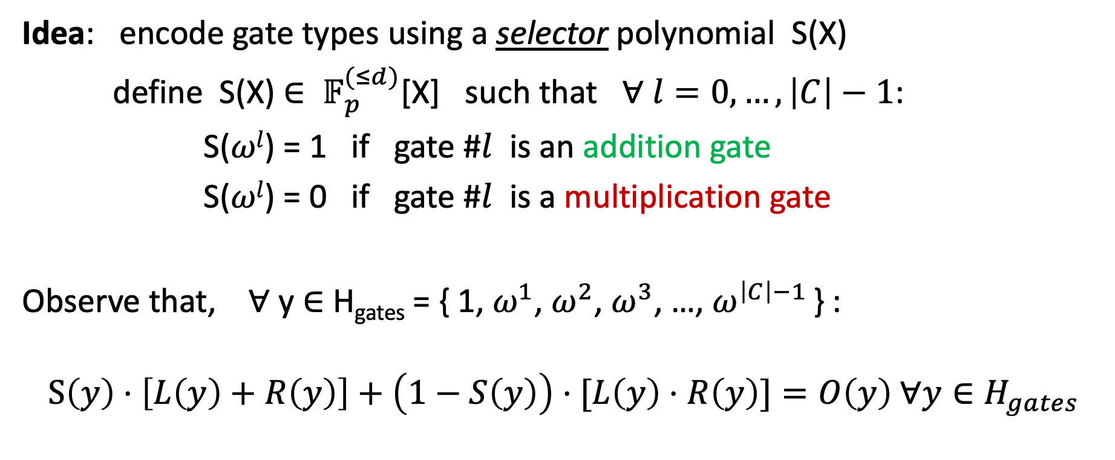
Plonk: Gate Check [GWC19]
Idea: encode gate types using a selector polynomial S(X)
define S(X) ${∈ 𝔽}_{p}^{(≤d)}$[X] such that ∀ $l=0,…,\left|C\right|−1$:
S($ωl$) = 1 if gate #$l$ is an addition gate
S($ωl$) = 0 if gate #$l$ is a multiplication gate
Observe that, ∀ y ∈ H_{gates} = { 1, $ω^{1}$, $ω^{2}$, $ω^{3}$, …, $ω^{\left|C\right|−1}$ } :
$$S\left(y\right)⋅\left[L\left(y\right)+R\left(y\right)\right]+\left(1−S\left(y\right)\right)⋅[L\left(y\right)⋅R\left(y\right)]=O\left(y\right) ∀y∈H_{gates}$$
Notes:
After interpolating the gate values to polynomials, we need to ensure that the trace encodes a valid circuit computation. This is done by checking a unified equation holds true for every point in the interpolated set H
First, we need a way to unify both addition gates and multiplication gates into a single formula. Plonk address it by introducing some preprocessed polys called selector polynomials that encode different gate types
Now, we only need to check that for each point in the set H, the following formula equal zero

Slide 15
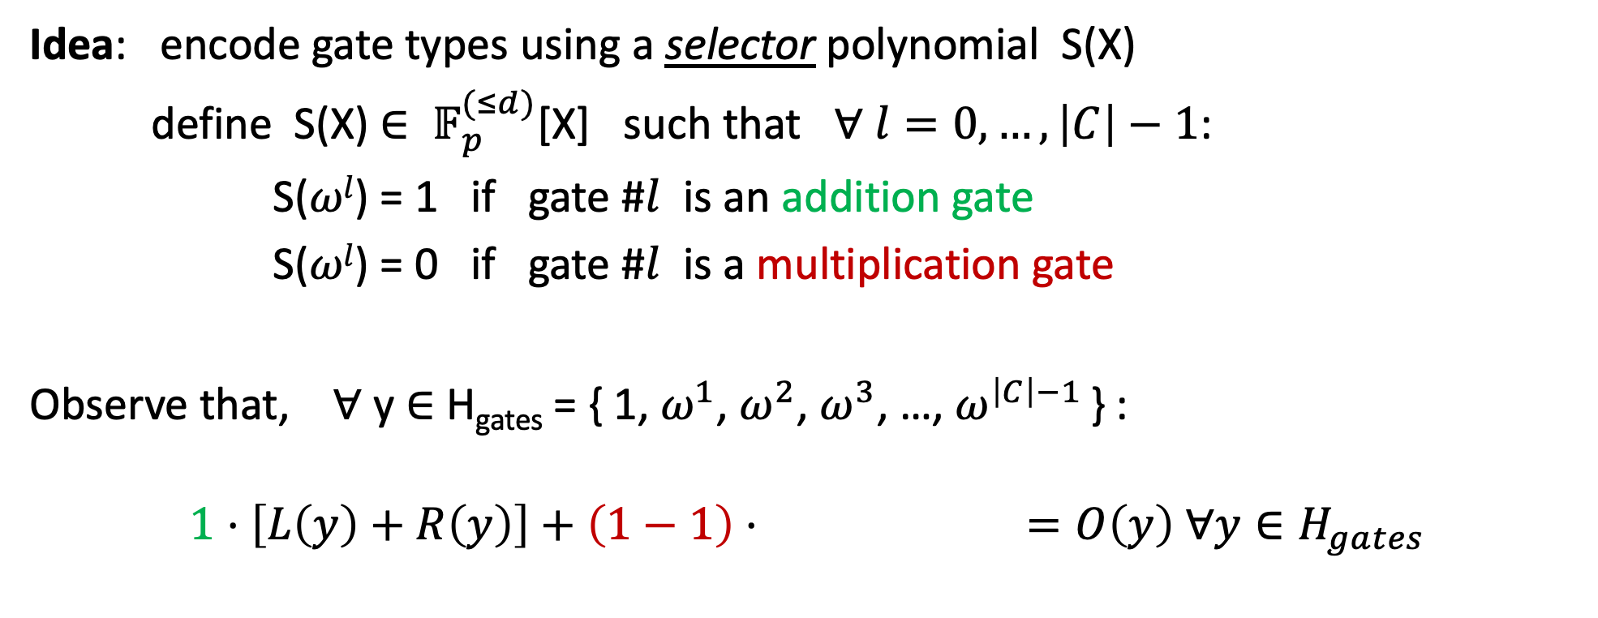
Plonk: Gate Check [GWC19]
Idea: encode gate types using a selector polynomial S(X)
define S(X) ${∈ 𝔽}_{p}^{(≤d)}$[X] such that ∀ $l=0,…,\left|C\right|−1$:
S($ωl$) = 1 if gate #$l$ is an addition gate
S($ωl$) = 0 if gate #$l$ is a multiplication gate
Observe that, ∀ y ∈ H_{gates} = { 1, $ω^{1}$, $ω^{2}$, $ω^{3}$, …, $ω^{\left|C\right|−1}$ } :
$$1⋅\left[L\left(y\right)+R\left(y\right)\right]+\left(1−1\right)⋅(L\left(y\right)⋅R(y)=O\left(y\right) ∀y∈H_{gates}$$
Addition gate

Slide 16
Plonk: Gate Check [GWC19]
Idea: encode gate types using a selector polynomial S(X)
define S(X) ${∈ 𝔽}_{p}^{(≤d)}$[X] such that ∀ $l=0,…,\left|C\right|−1$:
S($ωl$) = 1 if gate #$l$ is an addition gate
S($ωl$) = 0 if gate #$l$ is a multiplication gate
Observe that, ∀ y ∈ H_{gates} = { 1, $ω^{1}$, $ω^{2}$, $ω^{3}$, …, $ω^{\left|C\right|−1}$ } :
$$S\left(y\right)⋅\left[L\left(y\right)+R\left(y\right)\right]+\left(1−S\left(y\right)\right)⋅[L\left(y\right)⋅R\left(y\right)]=O\left(y\right) ∀y∈H_{gates}$$
Notes:
After interpolating the gate values to polynomials, we need to ensure that the trace encodes a valid circuit computation. This is done by checking a unified equation holds true for every point in the interpolated set H
First, we need a way to unify both addition gates and multiplication gates into a single formula. Plonk address it by introducing some preprocessed polys called selector polynomials that encode different gate types
Now, we only need to check that for each point in the set H, the following formula equal zero

Slide 17
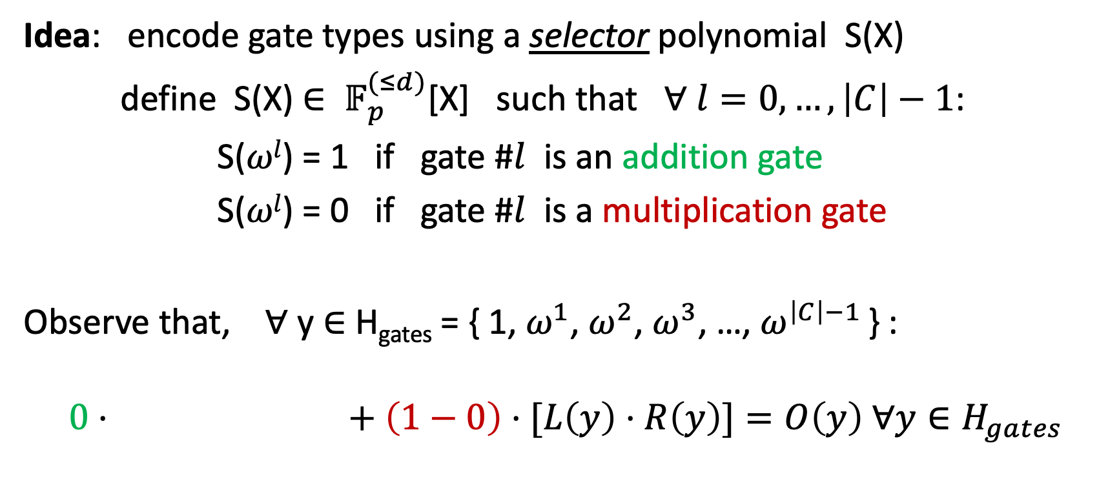
Plonk: Gate Check [GWC19]
[GWC19]
Idea: encode gate types using a selector polynomial S(X)
define S(X) ${∈ 𝔽}_{p}^{(≤d)}$[X] such that ∀ $l=0,…,\left|C\right|−1$:
S($ωl$) = 1 if gate #$l$ is an addition gate
S($ωl$) = 0 if gate #$l$ is a multiplication gate
Observe that, ∀ y ∈ H_{gates} = { 1, $ω^{1}$, $ω^{2}$, $ω^{3}$, …, $ω^{\left|C\right|−1}$ } :
$$0⋅\left[L\left(y\right)+R\left(y\right)\right]+\left(1−0\right)⋅[L\left(y\right)⋅R\left(y\right)]=O\left(y\right) ∀y∈H_{gates}$$
Multiplication gate

Slide 18
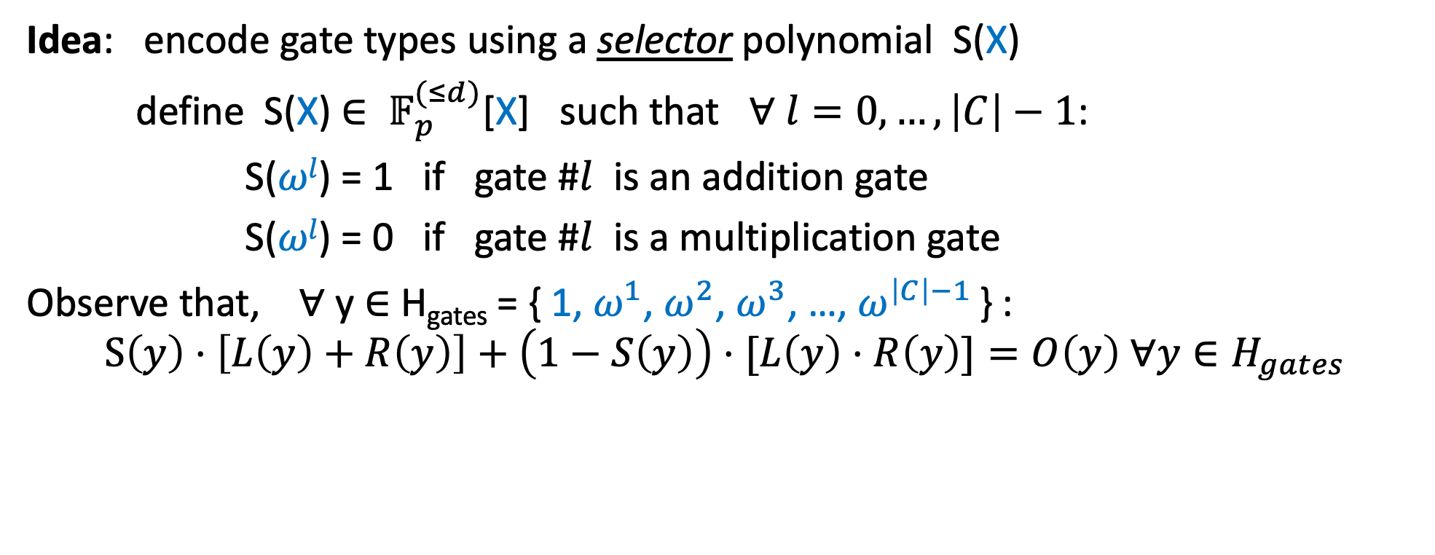
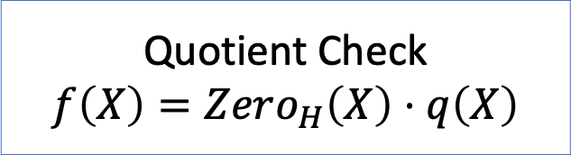
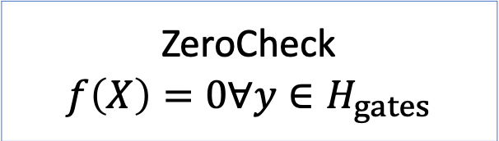
Plonk: Gate Check [GWC19]
[GWC19]
Idea: encode gate types using a selector polynomial S(X)
define S(X) ${∈ 𝔽}_{p}^{(≤d)}$[X] such that ∀ $l=0,…,\left|C\right|−1$:
S($ωl$) = 1 if gate #$l$ is an addition gate
S($ωl$) = 0 if gate #$l$ is a multiplication gate
Observe that, ∀ y ∈ H_{gates} = { 1, $ω^{1}$, $ω^{2}$, $ω^{3}$, …, $ω^{\left|C\right|−1}$ } :
$$S\left(y\right)⋅\left[L\left(y\right)+R\left(y\right)\right]+\left(1−S\left(y\right)\right)⋅[L\left(y\right)⋅R\left(y\right)]=O\left(y\right) ∀y∈H_{gates}$$
ZeroCheck
$$f\left(X\right)=0∀y∈H_{gates}$$
Quotient Check
$f\left(X\right)=Zero_{H}\left(X\right)⋅q\left(X\right)$
Notes:
Now the problem is reduced to a zerocheck where one wants to check that a formula evaluates to zero for each point in the set H
Plonk builds a protocol for this zerocheck relation, by showing that f can be divided by a zero polynomial that vanishes on the set H, or equivalently, by showing that f is a product of the zero polynomial and a quotient poly

Slide 19
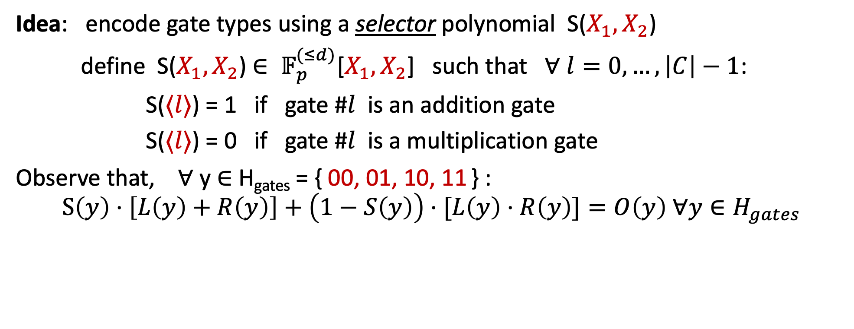
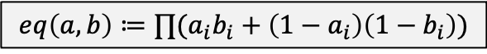
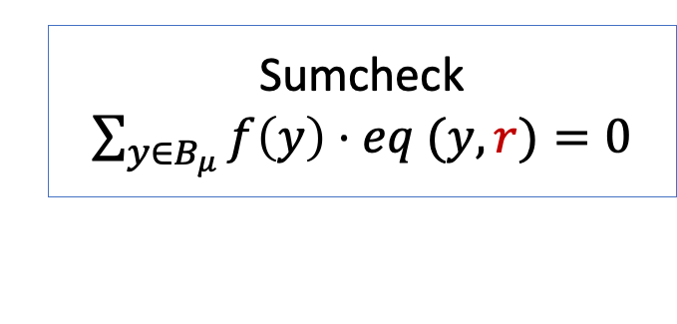
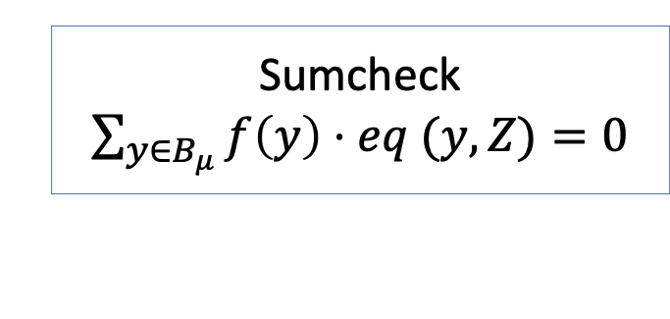
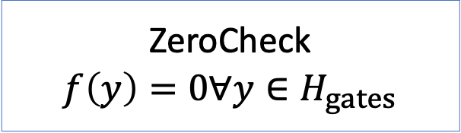
Hyperplonk: Gate Check
Idea: encode gate types using a selector polynomial S($X_{1},X_{2}$)
define S($X_{1},X_{2}$) ${∈ 𝔽}_{p}^{(≤d)}$[$X_{1},X_{2}$] such that ∀ $l=0,…,\left|C\right|−1$:
S($⟨l⟩$) = 1 if gate #$l$ is an addition gate
S($⟨l⟩$) = 0 if gate #$l$ is a multiplication gate
Observe that, ∀ y ∈ H_{gates} = { 00, 01, 10, 11 } :
$$S\left(y\right)⋅\left[L\left(y\right)+R\left(y\right)\right]+\left(1−S\left(y\right)\right)⋅[L\left(y\right)⋅R\left(y\right)]=O\left(y\right) ∀y∈H_{gates}$$
$$eq\left(a, b\right)≔∏(a_{i}b_{i}+\left(1−a_{i}\right)\left(1−b_{i}\right))$$
ZeroCheck
$$f\left(y\right)=0∀y∈H_{gates}$$
Sumcheck
$\sum_{y∈B_{μ}}{f\left(y\right)⋅eq (y, r)}=0$
Sumcheck
$\sum_{y∈B_{μ}}{f\left(y\right)⋅eq (y, Z)}=0$
random
No quotient check anymore
Schwartz-Zippel Lemma
Notes:
However, there is no such easy quotient check in the multilinear setting
Instead, we use a standard trick to transform the zerocheck into a sumcheck and solves it. Essentially…., f=0 everywhere iff the interpolated polynomial is identically zero, by SZ-lemma, it means that the random eval of it is zero, which is essentially a sumcheck
Even better, the use of sumcheck improves the prover time from quasilinear to linear and removes the need of FFTs and FFT-friendly fields.

Slide 20

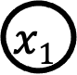


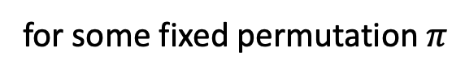

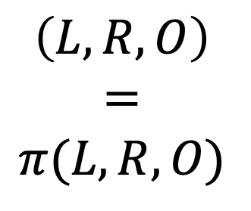
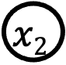
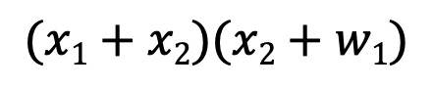
Wiring Identity Check
[GWC19]
The computation trace:
$$(x1+x2)(x2+w1)$$
L
R
O
77
inputs: 5, 6, 1
Gate 0: 5 , 6 , 11
Gate 1: 6 , 1 , 7
Gate 2: 11, 7, 77
$$\left(L, R, O\right)$$
$$=$$
$$π(L, R, O)$$
$$\text{×}$$
(Gate 2)
11
7
(Gate 0)
$$+$$
$$+$$
(Gate 1)
5
6
1
6
$$x1$$
$$x2$$
$$w1$$
All slots with the same color
should have identical values!
for some fixed permutation $π$
5
6
1
Notes:
Besides proving gate computation correctness, we also need to ensure that different gate values are consistent if they are connected by the same wire.
For example….
Plonk deal with it by proving that L, R, O’s evaluations is a prefixed permutation of itself, then reduce it to a multiset-equality check relation, which after further reductions finally come to quotient check again.

Slide 21
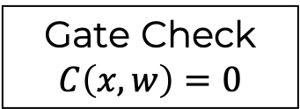

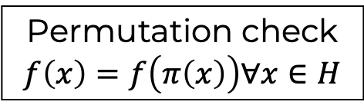

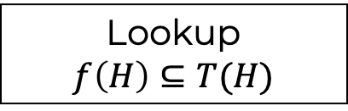
PLONK: Components
Ultraplonk
PLONK
Permutation check
$$f\left(x\right)=f\left(π\left(x\right)\right)∀x∈H$$
Lookup
$$f\left(H\right)⊆T(H)$$
Gate Check
$$C\left(x,w\right)=0$$
Multi-set check
$${\left\{(x_{1,i},x_{2,i})\right\}}_{i∈H}={\left\{(y_{1,i},y_{2,i})\right\}}_{i∈H}$$
Product check: $\prod_{x∈H}{f\left(x\right)=s}$
Zero check
$$f\left(x\right)=0 ∀x∈H$$
Quotient check
$$f(X)=q(X)∗Z_{H}(X)$$
Notes:
Essentially, we build a modular framework explaining the dependency of the protocols for different relations

Slide 22
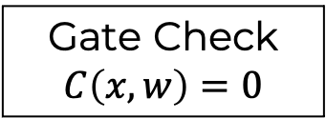


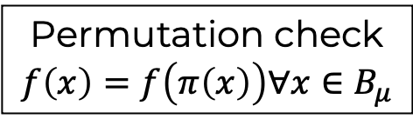

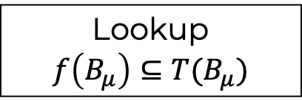
Hyperplonk: Components
Hyperplonk+
Hyperplonk
Permutation check
$$f\left(x\right)=f\left(π\left(x\right)\right)∀x∈B_{μ}$$
Lookup
$$f\left(B_{μ}\right)⊆T(B_{μ})$$
Gate Check
$$C\left(x,w\right)=0$$
Multi-set check
$${\left\{(x_{1,i},x_{2,i})\right\}}_{i∈H}={\left\{(y_{1,i},y_{2,i})\right\}}_{i∈H}$$
Product check: $\prod_{x∈B_{μ}}{f\left(x\right)=s}$
Zero check
$$f\left(x\right)=0 ∀x∈B_{μ}$$
Sumcheck: $\sum_{x∈B_{μ}}{f\left(X\right)=s }$
Notes:
and extend them to the multi-variate setting
a key difference is that at the bottom, we replace the quotient check with the classic sumcheck protocol

Slide 23
Outline
Adapt Plonk to the Boolean hypercube
High-degree gates support and batching
Hyperplonk+: support lookup on the Boolean hypercube
Evaluations
Notes:
A key advantage of moving to the multilinear setting is that enables much better high-deg custom gate support

Slide 24
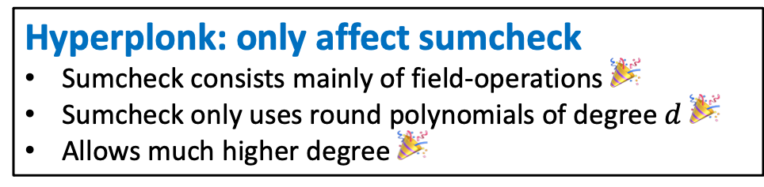
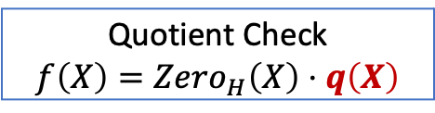
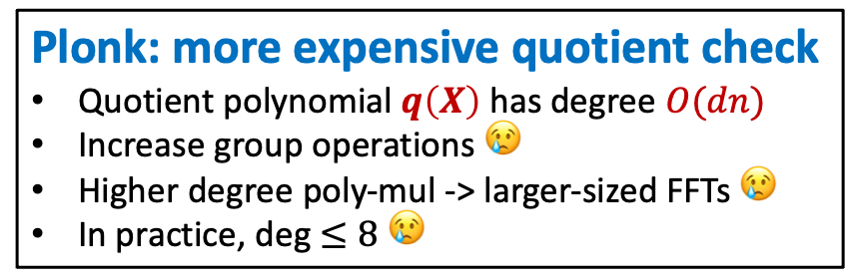


Hyperplonk: High degree gates
$$S\left(y\right)⋅\left[L\left(y\right)+R\left(y\right)\right]+\left(1−S\left(y\right)\right)⋅[L\left(y\right)⋅R\left(y\right)]=O\left(y\right) ∀y∈H_{gates}$$
The gate formula can be more general
e.g. more selectors and more different custom gates
high degree, e.g., $L{\left(y\right)}^{5}+R(y)$
$$S\left(y\right)⋅\left[L\left(y\right)+R\left(y\right)\right]+\left(1−S\left(y\right)\right)⋅[G(L\left(y\right),R\left(y\right))]=O\left(y\right) ∀y∈H_{gates}$$
Benefit: reduce the size of the circuit/witness -> faster prover
Plonk: more expensive quotient check
Quotient polynomial $q\left(X\right)$ has degree $O(dn)$
Increase group operations 😢
Higher degree poly-mul -> larger-sized FFTs 😢
In practice, deg $≤8$ 😢
Hyperplonk: only affect sumcheck
Sumcheck consists mainly of field-operations 🎉
Sumcheck only uses round polynomials of degree $d$ 🎉
Allows much higher degree 🎉
V.S.
Sumcheck
$\sum_{y∈B_{μ}}{f\left(y\right)⋅eq (y, r)}=0$
Quotient Check
$f\left(X\right)=Zero_{H}\left(X\right)⋅q\left(X\right)$
Notes:
Recall the simplified Plonk constraint formula, it is a degree-3 formula as there is a product of S, L and R
In practice, we can possibly use other types of gates with much higher degree…
More generally, we can embed more custom gate types using different selectors
Useful for decreasing the circuit size for certain func, e.g., ECC addition, Rescue round func
Plonk: the power of custom high-de gate is limited: quotient check, quotient poly deg
q’s commitment: more G-exp if we use KZG, larger FFT if FRI-PCS with high rate
Poly-mul
Hyperplonk: only affect the sumcheck but not the PCS
sumcheck: linear-time and only involves field ops, makes it less expensive than PCS part
This enables the use of super-high degree gates, and even if we are using a very-high degree gate, the cost of sumcheck over high-deg poly can still be less expensive than the PCS part

Slide 25
Evaluations: High-degree Gates
Degree 32 is only 20% more expensive than degree 2
Notes:
This is justified by our evaluations, where…

Slide 26










Efficient Sumcheck for High-degree Polynomials
Goal: “convince” V that $\sum_{x∈B_{μ}}{f\left(X\right)=s }$
Prover
$r_{μ}\left(X\right)=$ $\sum_{b∈B_{μ−1}}{f\left(b,X\right) }$
Verifier
$$α_{u}←𝔽_{p}$$
check $r_{μ}\left(0\right)+r_{μ}\left(1\right)=s$
……
$r_{i}\left(X\right)=$ $\sum_{b∈B_{i−1}}{f\left(b,X,α_{i+1},…,α_{μ}\right) }$
check $r_{i}\left(0\right)+r_{i}\left(1\right)=r_{i+1}(α_{i+1})$
$$α_{i}←𝔽_{p}$$
……
……
check $f\left(α_{1},…,α_{μ}\right)=r_{1}(α_{1})$
Optimizations to the classic Sumcheck [LFKN92]
Sending $r_{i}$as univariate oracles ($d$ field elems -> 1 group elem)
Decrease the number of queries per round: 3 queries -> 1 query
More efficient algorithm for computing Sumcheck for high-degree polynomials
$O\left(2^{u}d^{2}\right)→O(2^{μ}d\log^{2}d)$ (and $O(2^{μ}dlogd)$ for certain custom gates)
In practice, replace FFTs with Karatsuba
No proof size/verifier
dependence on $d$ anymore
Notes:
optimizations to the classic sumcheck protocol in the high-degree polynomial setting
Sumcheck is a protocol proving that the evaluations of a polynomial on the Boolean hypercube sum to certain value
In each round, the prover sends a degree d univariate polynomial r_i, the verifier evaluate r_i at point 0, 1 and r_i+1 at a random point a_i+1, and applies some simple check, and sample and sends a random challenge a_{i} back
Finally, the verifier queries the multivariate polynomial f at a single random point
In the classic sumcheck, each ri is sent as d evaluations, we observe that…it’s compiled to a commitment in the resulting SNARK, this improves the communication from d F per rounds to a single group elem per round, and thus no ...
Recall for each ri, there are 3 eval queries to it, finally, we also propose a more .... the algorithm needs to perform some mul between deg-d poly, in practice, since d won't be larger than a hundred, we can use karatsuba for mul, which is still super efficient and fully remove FFTs

Slide 27





The Hyperplonk PolyIOP
Preprocessor S($C$)
oracle
$$S\left(\vec{x}\right),π\left(\vec{x}\right)$$
can be a single commitment
Prover P($\text{S}\text{p}\text{,}x, w$)
$$L(\vec{x}), R(\vec{x}), O(\vec{x})$$
Verifier V($\text{S}\text{v}\text{, }x$)
oracle
PolyIOP for gate check
The underlying Sumchecks
can be batched
PolyIOP for wiring check
many PCS eval proofs 😢
PolyIOP for batch evaluate
14+ poly eval queries?
A single PCS eval proof
in the SNARK
A single evaluation query
on a multilinear polynomial
Notes:
In summary, we obtain a multivariate PolyIOP as follows
Preprocessing phase
Online phase
PolyIOPs
Finally, the verifier asks many evaluation queries to the polynomials. In the Vanila plonk constraint system, this leads to 14 queries, and it can be even more if use higher-deg gates or lookup gates
This leads to an efficiency issue on the resulting SNARKs…
To address the issue, we also design a PolyIOP for the batch evaluation, that reduces multiple eval queries into a single eval query, hence the SNARK only needs to provide a single PCS evaluation proof.

Slide 28



Efficient Batch Evaluations
Goal: “convince” V that $f_{i}\left(z_{i}\right)=y_{i}∀i∈[k]$ ($f_{i}∈𝔽_{p}\left[X_{1},…,X_{μ}\right]$)
Prover P($\text{S}\text{p}\text{,}x, w$)
Verifier V($\text{S}\text{v}\text{, }x$)
PolyIOP for batch evaluate
A single PCS eval proof
in the SNARK
A single evaluation query
on a multilinear polynomial
Requirements
Prover time $≈$ the time complexity of k poly evaluations
Logarithmic communication/rounds and verification time
State-of-the-arts
Halo-infinite [BDFG20] only works for univariate polys
Thaler’s solution has prover time $O(k^{2}μ⋅2^{μ})$
Our results
Prover time $O\left(k2^{μ}\right)$ (optimal)
$kμ$-factor improvement (k>13 in HP)
$O(μ)$ communication
$O\left(kμ\right)$ verification time
Notes:
Look deeper on how batching works P’s goal: convince the verifier that k polynomial evaluations are correct, where each query can involve different polynomials and different points
We hope to build a protocol that transforms these k queries into a single query
We require this protocol to be efficient, namely,…
There do exist certain protocols that deal with batch evaluations, but they do not meet our requirements here…
Given this, we improve the state-of-the art by proposing a batching protocol with prover time... Our results..already optimal…improve…log proof size/vericiation time good constant

Slide 29










Efficient Batch Evaluation
Goal: “convince” V that $f_{i}\left(z_{i}\right)=y_{i}∀i∈[k]$ ($f_{i}∈𝔽_{p}\left[X_{1},…,X_{μ}\right]$)
Toy case: $k=1$
$$eq\left(a, b\right)≔∏(a_{i}b_{i}+\left(1−a_{i}\right)\left(1−b_{i}\right))$$
$$f_{i}$$
$$f_{i}(⟨0⟩)$$
$$f_{i}(⟨1⟩)$$
…
…
$$f_{i}(⟨j⟩)$$
…
…
…
$$f_{i}(⟨2^{μ}⟩)$$
$$eq$$
$$eq(\left\langle 0\right\rangle ,z_{i})$$
$$eq(\left\langle 1\right\rangle ,z_{i})$$
…
…
$$eq(\left\langle j\right\rangle ,z_{i})$$
…
…
…
$$eq(\left\langle 2^{u}\right\rangle ,z_{i})$$
It is a sumcheck!
Can be reduced to a single evaluation
What if $k>1$?
Sumcheck is batchable!
Reduces $f_{1}\left(z_{1}\right)=y_{1},…,f_{k}\left(z_{k}\right)=y_{k}$ to $f^{∗}(r_{2})$
${f^{∗}≔\tilde{f}}_{\vec{α}}(r_{1}, ⋅)$ is a linear comb. of $\left\{f_{i}\right\}$
Uses PCS Homomorphism
$$+$$
$$+$$
$f_{i}\left(z_{i}\right)$ =
$$+$$
$$=y_{i}$$
$$+$$
$$+$$
$$+$$
$$+$$
$$+$$
multilinear extension
Notes:
Recall that our goal is to prove f_i(z_i) = y for every i in 1..k.
To illustrate the key idea, we start with the simplest case where there is only 1 evaluation
To prove that fi(zi) = yi, a key trick is to rewrite the evaluation of fi(zi) as its interpolation form, in the multlinear setting, this is called multilinear extension
We list the evaluations of fi on the Boolean hypercube
Then f’s evaluation on an arbitrary point Zi can be expressed as the sum of a tensor product that’s related to both the evaluations on the Boolean hypercube and the point Zi
And it’s essentially a sumcheck, and looking ahead, we note that the classic sumcheck protocol has a nice property that the verifier only queries the polynomial at a single point, thus….
However, it improves nothing in the case of k = 1 as we only have a single evaluation in the first place.
But the nice thing is that this idea can be easily generalized to case of k > 1 because sumcheck has a nice batching feature

Slide 30










Efficient Batch Evaluation
Goal: “convince” V that $f_{i}\left(z_{i}\right)=y_{i}∀i∈[k]$ ($f_{i}∈𝔽_{p}\left[X_{1},…,X_{μ}\right]$)
General case: $k>1$
for simplicity, assume $y_{i}=0$
MLE + SZ-lemma
Expand $f_{i}\left(z_{i}\right)$ again
$$∀i∈\left[k\right]$$
$f_{i}\left(z_{i}\right)=0$
$$\sum_{⟨i⟩∈B_{ℓ}}{f_{i}\left(z_{i}\right)⋅eq \left(\left\langle i\right\rangle , \vec{α}\right)=0}$$
$$\sum_{(\left\langle i\right\rangle , b)∈B_{μ+log(k)}}{f_{i}\left(b\right)⋅eq\left(b,z_{i}\right)⋅eq\left(\left\langle i\right\rangle ,\vec{α}\right)}=0$$
random
Sumcheck again!
Observations
A deg-2 Sumcheck with $μ+log(k)$ rounds
Reduced to a single random evaluation ${\tilde{f}}_{\vec{α}}(r_{1},r_{2})⋅\tilde{eq}(r_{1}, r_{2})$
${f^{∗}≔\tilde{f}}_{\vec{α}}(r_{1}, ⋅)$ is a linear combine of $\left\{f_{i}\right\}$
$\tilde{eq}$ efficiently computable by verifier
1 PCS evaluation proof for $f^{∗}(r_{2})$ suffices
Can be optimize to $μ$ rounds
$$\sum_{(\left\langle i\right\rangle , b)∈B_{μ+log(k)}}{{\tilde{f}}_{\vec{α}}\left(\left\langle i\right\rangle , b\right)⋅\tilde{eq}\left(\left\langle i\right\rangle , b\right)}=0$$
$$\tilde{eq}(\left\langle i\right\rangle ,b)=MLE\left({\left\{eq(b,z_{i}) \right\}}_{\left\langle i\right\rangle ∈B_{log(k)}, b∈B_{μ}}\right)$$
$$\tilde{f_{\vec{α}}}\left(\left\langle i\right\rangle ,b\right)=MLE\left({\left\{f_{i}\left(b\right)⋅eq\left(\left\langle i\right\rangle ,\vec{α}\right)\right\}}_{\left\langle i\right\rangle ∈B_{\log\left(k\right)}, b∈B_{μ}}\right)$$
Notes:
For simplicity, ….
We can reuse the previous trick to combine fi(zi) into a random sum, and our goal is to prove that the sum equals 0.
Next, we can use MLE and expand fi(zi) again, which gives another form of sumcheck over the boolean hypercube.
The sumcheck is for the product of 2 multiilnear polynomials, where the 1st is the MLE of the green part, and the other poly is the MLE of the orange part.
Since it’s only degree 2, we can just reuse the classic sumcheck protocol without any new optimizations, and it will still be super efficient.
The sumcheck has u+logk rounds, but there are tricks to reduce it to \mu rounds, which further improves proof size and verification time
Finally, the sumcheck is reduced to a single random evaluations
We can define f* which is lin-comb…, and since … verifier
as long as the PCS is homomorphic, the SNARK prover only needs to provide a single evaluation proof for f’* with \mu variables,
and the verifier can reconstruct the poly commitment from the set of commitments to {f_i}, and then check the proof

Slide 31



Proving Relations between Vector Commitments
Goal: prove that $f_{a_{i}}=g_{b_{i}}∀i∈[k]$
($f,g∈𝔽^{n}$ are vectors, $a_{i},b_{i}∈[n]$ are indices)
Goal: prove that $f\left(a_{i}\right)=g(b_{i})∀i∈[k]$
($a_{i},b_{i}$ are in the Boolean hypercube)
Our results
Prover time $O\left(2^{μ}\right)$
Particularly useful for building Commit-and-Prove SNARKs from multilinear polys
One of the key building blocks in the Orion+ PCS construction

Slide 32
Outline
Adapt Plonk to the Boolean hypercube
High-degree gates support and batching
Hyperplonk+: support lookup on the Boolean hypercube
Evaluations
Notes:
Next, I’ll focus on one cool feature that we achieve, namely extending HyperPlonk to also support lookup

Slide 33





Hyperplonk with Lookup Gates
Range check:
Bit operation:
Expensive to express
with arithmetic gates
11
$$∈\{0,1,…,2^{16}\}$$
3=011
(Gate i)
$$+$$
(Gate i)
$$⊕$$
5
6
5=101
6=110
$$x∈[0..2^{16})$$
0
1
2
…
2¹⁶-1
(0,0,0)
…
(5,6,3)
…
(15,8,7)
$$\left(x,y,z\right)∈{\left\{0,1\right\}}^{8}×{\left\{0,1\right\}}^{8}×{\left\{0,1\right\}}^{8}$$
1 lookup gate suffices!
precomputed
precomputed
Notes:
Before delving to the technical details, let’s see why we need lookup gates.
Given an arithmetic circuits, sometimes…Range check
SHA256: bit ops
Expensive to express by with only addition and multiplication, e.g. to do range check, ….
if we can precompute a table that stores the valid values, and if we can efficiently prove that a certain tuple is in the table, we can do things much more efficiently

Slide 34





















The Idea of Plookup [GW20]
Lookup relation: $f\left(H\right)⊆T\left(H\right)$ for some preprocessed $T$ and some witness $f$
Completeness
Soundness
Lookup relation
$$f$$
1
1
3
2
$$f$$
1
1
3
2
$$h$$
$$h_{↻}$$
$$h$$
…
…
?
5
5
…
…
…
$$h_{↻}$$
…
…
5
5
?
…
…
…
$$h$$
1
1
1
2
2
3
3
4
$$h_{↻}$$
1
1
2
2
3
3
4
1
$$f$$
1
1
3
2
$$T$$
1
2
3
4
$$1$$
$$ω$$
$$⊆$$
never appear
on the left
$$H$$
$$=$$
$$≠$$
$$ω^{2}$$
5
5
?
$$ω^{3}$$
5
$$T$$
1
2
3
4
$$T_{↻}$$
2
3
4
1
invalid
It’s easy to perform rotation in $H$ for univariate polynomials: $H→ωH$
How to do it in the Boolean hypercube for multilinear polynomials?
Multiset Equality Check
Notes:
Given two vectors f, T, how can you prove that each element in f is inside the table T?
Plookup is an elegant scheme that solves it by interpolating the vectors onto a set H of univ….and transform..which is much easier…
The set H is …
The transformation builds a set of pair elements from f and T as follows
first, we copy and paste f to obtain 4 pairs, where each pair is an f’s element occurred twice
second, we copy and paste T, but also rotate T by one position, which also lead to 4 pairs, where each pair is a T’s element and its successor
Plookup argue that …if and only if the set of adjacent pairs…
Completeness: sort f, T according to T’s order
Soundness
Univariate PIOP essentially use the fact that H can be rotated efficiently…
No longer trivial…
Q: Why not directly using preprocessed permutation argument for shifting?
A: Requires an additional permutation argument, extra cost

Slide 35
The Idea of Plookup [GW20]
Lookup relation: $f\left(H\right)⊆T\left(H\right)$ for some preprocessed $T$ and some witness $f$
Lookup relation
$$f$$
1
1
3
2
$$f$$
1
1
3
2
$$h$$
$$h_{↻}$$
$$h$$
1
1
1
2
2
3
3
4
$$h_{↻}$$
1
1
2
2
3
3
4
1
$$f$$
1
1
3
2
$$T$$
1
2
3
4
$$1$$
$$ω$$
$$⊆$$
$$H$$
$$=$$
$$ω^{2}$$
?
$$ω^{3}$$
$$T$$
1
2
3
4
$$T_{↻}$$
2
3
4
1
It’s easy to perform rotation in $H$ for univariate polynomials: $H→ωH$
How to do it in the Boolean hypercube for multilinear polynomials?
Multiset Equality Check

Slide 36









Rotation in the Boolean Hypercube
Step 1: Build a generator for the Boolean hypercube by simulating $𝔽_{2^{u}}$
Cool connection with short PCP
[Ben-Sasson, Sudan 05]
Let $p_{μ}\left(X\right)∈𝔽_{2}^{μ}\left[X\right]$ be a primitive polynomial of degree $μ$
$$𝔽_{2}\left[X\right]/(p_{u})$$
$$≅𝔽_{2^{u}}$$
and $X$ is a generator of $𝔽_{2^{u}} \backslash \{0\}$!
E.g. $p_{μ}\left(X\right)=X^{4}+X+1$
$$b_{3}X^{4}+b_{2}X^{3}+b_{1}X^{2}+b_{0}X$$
$$=b_{2}X^{3}+b_{1}X^{2}+{(b}_{0}⊕b_{3})X+b_{3}$$
$$b_{3}X^{3}+b_{2}X^{2}+b_{1}X+b_{0}$$
multiply $X$
$$u=(b_{3},b_{2},b_{1},b_{0}){∈𝔽}_{2^{4}} \backslash \{0\}$$
$$next(u)=(b_{2},b_{1},b_{0}⊕b_{3},b_{3}){∈𝔽}_{2^{4}} \backslash \{0\}$$
Caveats
The next() function is quadratic in some dimensions
Degree of $f(next\left(X\right))$ blowup
More expensive sumcheck!
0001
0010
0100
1000
0011
0110
1110
0111
1010
0101
1011
1100
1111
1101
1001

Slide 37


Rotation in the Boolean Hypercube
Step 2: Simulate $f(next\left(X\right))$ on the Boolean hypercube using a multilinear polynomial!
$$u=(b_{3},b_{2},b_{1},b_{0}){∈𝔽}_{2^{4}} \backslash \{0\}$$
multiply $X$
$$next(u)=(b_{2},b_{1},b_{0}⊕b_{3},b_{3}){∈𝔽}_{2^{4}} \backslash \{0\}$$
Define
Idea: enumerate the value of $b_{3}$ and linearize next()!
$$f_{↻}\left(X_{3},…, X_{0}\right)≔X_{3}⋅f\left(X_{2}, X_{1},{1−X}_{0}, 1 \right)+\left(1−X_{3}\right)⋅f(X_{2},X_{1},X_{0},0)$$
$f_{↻}$ computable from $f$ and is consistent with $f(next\left(X\right))$ on the Boolean hypercube!
Case $b_{3}=1$: $f_{↻}\left(b_{3},…, b_{0}\right)≔1⋅f\left(b_{2}, b_{1}, 1−b_{0},1\right)+\left(1−1\right)⋅f\left(0,X_{0},X_{1},X_{2}\right)=f\left(b_{2}, b_{1}, b_{0}⊕b_{3}, b_{3} \right)$
Case $b_{3}=0$: $f_{↻}\left(b_{3},…, b_{0}\right)≔0⋅f\left(1, {1−b}_{0}, b_{1},b_{2}\right)+\left(1−0\right)⋅f\left(b_{2},b_{1},b_{0},0\right)=f\left(b_{2}, b_{1}, b_{0}⊕b_{3},b_{3}\right)$
Can directly work on the multilinear $f_{↻}$ now! -> linear-time lookup PIOP
Notes:
Align better

Slide 38
Outline
Adapt Plonk to the Boolean hypercube
High-degree gates support and batching
Hyperplonk+: support lookup on the Boolean hypercube
Evaluations
Notes:
Finally, we briefly state our evaluation results. Note that the current implementation is only a proof-of-concept and misses many optimizations we described in the paper (lookup didn’t), we are planning to implement them soon and hopefully we can see further performance improvement
Post a new benchmark in the paper soon

Slide 39

Evaluations*
Proof size ($μ$=20)(with KZG PCS)
Plonk ~1kb
HP 6kb
Spartan 40kb
Implementation
Jellyfish: highly optimized
HP: many possible improvements
Prover time
HP outperforms Plonk at $2^{14}$; at $2^{20}$ HP is 1/3rd faster then Plonk
More parallelizable!
Spartan-KZG is also fast, but it uses R1CS, which has larger circuit sizes for many applications (e.g. zkRollup, zkEVM)
Notes:
But even with current raw implementation, HyperPlonk already did quite well
Proof size: logarithmic, slightly larger but comparable, much better than most of …
We compare our PoC implementation with a highly-optimized Plonk implementation called Jellyfish
It turns out ….gap grows….more parallelizable and hardware friendly
compare HyperPlonk with a variant of SpartanSNARK that is plugged with the KZG PCS for fair comparison. Also fast but R1CS, more constraints for zkRollup or Zcash apps
HyperPlonk more efficient thanks to its great support for high-deg gate

Slide 40

Cost Breakdown
Bottleneck
PCS commitments and openings
The current impl does 3 separate PCS batch openings
Expect significant improvement after having a single batching
Notes:
Plenty of spaces for impl optimizations
PCS part is much more expensive than PIOP part
3 separate PCS batch eval proofs -> no reason if want better efficiency -> combine and run only a single eval proof

Slide 41
Summary
Hyperplonk: A new PLONK-based PolyIOP with linear-time prover
No FFTs, better high-degree custom gates support
Can be made ZK
Hyperplonk+: extend Hyperplonk to support lookup
New multilinear polynomial commitments
Orion+
Preserve linear-time prover (O(n) field operations)
Improved proof size: 5MB -> 7KB (for 27 variables)
New FRI-based multilinear commitment scheme
Generic transformation from univariate PCS to multilinear PCS

Slide 42
Questions?
https://eprint.iacr.org/2022/1355.pdf
Notes:
Add eprint address

